Slide 1
Chapter 13: Architecture Patterns
Software architecture in Practice Chapter 13

Slide 2
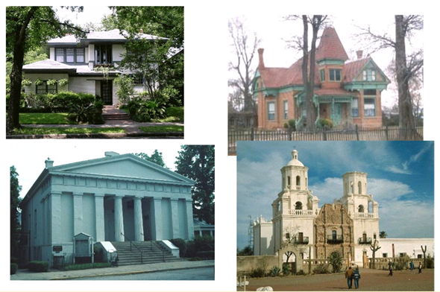
Architectural Styles (Patterns)

Slide 3
Patterns – a Review
Work on software patterns stemmed from work on patterns for building architecture carried out by Christopher Alexander (A Pattern Language: Towns, Buildings, Construction (1977))
Repeatable solutions for designing livable towns.
  e.g. “windows should allow natural light”
  Many people do “suboptimal” design decisions
  Saves time & provide a common language
    HashMap / TreeMap – don’t need to explain
  Otherwise – independent discovery
All well-structured software systems are full of patterns
  Architectural patterns – system level structural organization, e.g. Layered
  Design patterns – component level design, e.g. Observer
  Programming idioms – reoccurring constructs expressed in different languages (programming tasks, algorithms, data structures; e.g. increment counter)
Notes:
What is a TreeMap?

Slide 4
What is a Software Architectural Pattern?
Pattern - a solution to a problem in a context
  Context - common situation in the world that gives rise to a problem
  Problem – generalized problem regularly arising in the given context
  Solution - abstracted architectural resolution to the problem
Architectural pattern expresses a fundamental structural organization abstraction for software systems
  Set of structural elements
  Their relationships
  Rules and guidelines for organizing the relationships between them
    e.g. layered architecture – only downward relationships (UI → business logic → data layer)
  E.g.
    Client-server – architectural
    Factory – not architectural

Slide 5
Software Architecture Patterns
Vs software design patterns – higher level system wide in scope ; some overlap
  Recall the distinction between architecture and design work
How do you think about software design?
Essentially the same cognitive process for architecture design …
  Requirements driven, separation of concerns, top-down, apply patterns
Most systems cannot be structured according to a single architectural pattern
  Example: Design a system for Scalability & Adaptability
    Scalability → e.g. microservices or event-driven
    Adaptability of their user interfaces → e.g. MVC or Layered – can switch views

Slide 6
Describing a Pattern Solution
Pattern is not just a name.
Must specify:
  Set of element types (e.g. data repositories, processes, and objects)
  Set of interaction mechanisms or connectors (e.g. method calls, events, or message bus)
  Topological layout of the components (e.g. a pipeline of filters)
  Set of semantic constraints covering topology, element behavior, and interaction mechanisms (e.g. who can call who, guaranteed delivery, etc)
Organize patterns by predominant structure – module, connector, allocation
specify the form (what exists)
specify the rules (how it must behave)

Slide 7
A Pattern Catalog
Module | Component & Connector | Allocation
Layered* | Broker* | Map-Reduce*
Domain decomposition | Model-View-Controller* | Multi-tier functional mapping*
 | Pipe-and-Filter* | Platform
 | Client-Server* | Team work allocation
 | Peer-to-Peer*
 | Service-Oriented Architecture*
 | Microservices*
 | Publish-Subscribe (Observer)*
 | Shared-Data*
 | Blackboard*
 | Event Driven*
* Covered in this lecture

Slide 8
Module Patterns
decomposition of the system

Slide 9
Layered Pattern
Context
  Complex systems need to develop and evolve parts of the system independently
    Huge/multiple teams → connections grow non-linearly
    Suboptimal technologies → different stack per feature
    Dynamic environment → changing requirements
  Developers need well-documented separation of concerns
    Reusable central services → dedicated infrastructure layer with stable interface
  Primary QA: Modifiability
Problem
    Segment software so modules can be developed and evolved separately with little interaction, supporting portability, modifiability, and reuse
    Teams work independently → minimize interdependency
    Technologies differ per component → impossible to unify
    DB-specific code everywhere; business logic leaks into UI layer

Slide 10
Layered Pattern
Solution
  Divide the software into layers (set of elements / topology)
    Each layer is a grouping of modules that offers a cohesive set of services
    Usage must be unidirectional (semantic constraints)
    Each layer is exposed through a public interface (interaction mechanisms)
Benefits
  Modifiability – can change layers while contracts are maintained
  Portability – same business logic everywhere
  Team specialization – FE, BE, DB, etc
  Testability – each layer can be tested in isolation
Weaknesses
  The addition of layers adds up-front cost and complexity to a system.
  Layers contribute a performance penalty

Slide 11
Layered Pattern – Specification
Elements
Layer, a kind of module – the description of a layer should define what modules the layer contains.
Relations
Allowed to use – the design should define what the layer usage rules are and any allowable exceptions.
Constraints
  Every piece of software is allocated to exactly one layer.
  There are at least two layers (but usually there are three or more).
  The allowed-to-use relations should not be circular (i.e., a lower layer cannot use a layer above)

Slide 12
UML Package Notation for Layer Diagrams
Notes: The textbook uses various informal architecture notations. That is OK if you use legends (keys) to explain the components, connectors, and structures.
A layer is allowed to use the next lower layer

Slide 13
Business IT Example
CLOSED = all requests must pass through
OPEN = layer may be bypassed
Software Architecture Patterns, Mark Richards

Slide 14
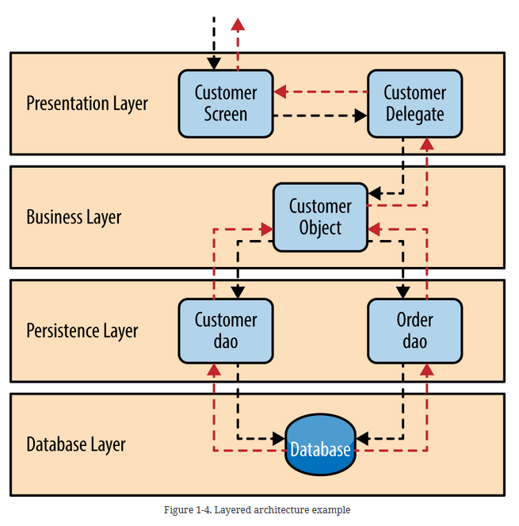
Layered Architecture Example
Note how:
Customer Delegate decouples Presentation from direct Business Layer calls
Only higher layers call lower layers (unidirectional)
Request
Response
Software Architecture Patterns, Mark Richards

Slide 15
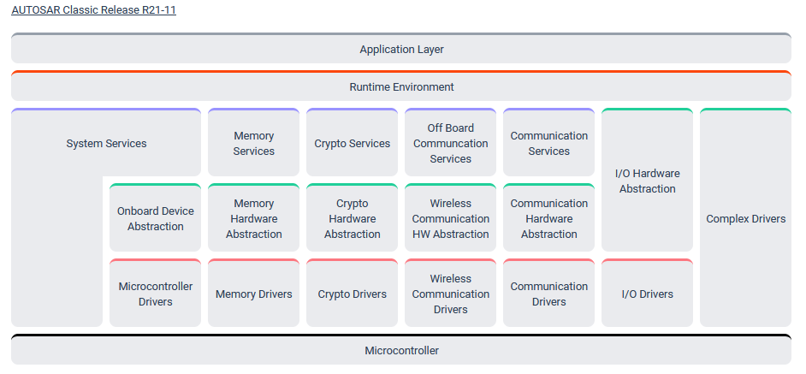
AUTOSAR Layered Architecture
AUTOSAR: the standard software architecture for automotive ECUs (Electronic Control Units)
Abstraction layer allows the application layer to run unchanged on any microcontroller - Portability

Slide 16
Component & Connector Patterns
decomposition of the system

Slide 17
Model-View-Controller Pattern
Context
  UI is typically the most frequently modified part of an application
  Users often wish to look at data from different perspectives
    e.g. a bar graph or a pie chart or filtered by an attribute or grouped by a department
  Multiple UI implementations may exist – desktop, mobile, command line
  These representations should all reflect the current state of the data
  Primary QA: Modifiability
Problem: How can we evolve the UI independently from business logic, while keeping multiple view implementations synchronized with the same underlying data?
  Separate UI from core logic
    To avoid logic modification when UI changes
    To avoid duplication across multiple UI implementations
  Keep UI & data synchronized
  Support multiple view representations

Slide 18
Model-View-Controller Pattern
Solution: The model-view-controller (MVC) pattern separates application functionality into three kinds of components:
  Model – contains the application's data & business logic
  View – displays some portion of the underlying data and interacts with the user
  Controller – mediates between the model and the view
Benefits
  Multiple views – desktop app, mobile app, pie chart, bar chart
  Easy to modify – change UI without touching anything else
  Reusability – same model & controller reused for different UIs
Weaknesses
  May be too complex for simple user interfaces
  May not be a good fit for some UI toolkits
  Controller bloat – logic gradually migrates into the Controller, turning it into a God Object

Slide 19
Model-View-Controller – Specification
Elements
  The model is a representation of the application data or state, and it contains (or provides an interface to) application logic.
  The view is a UI component that produces a representation of the model or allows user input, or both.
  The controller manages the interaction between model and view, translating user actions into model or view changes.
Relations
  Uses — Controller calls Model to update state and View to select display (invocation — synchronous method call)
  Notifies — Model notifies View of state changes (event/notification — Observer pattern)
Constraints
  Must be at least one model, view, and controller.
  Model should not interact directly with the controller.

Slide 20
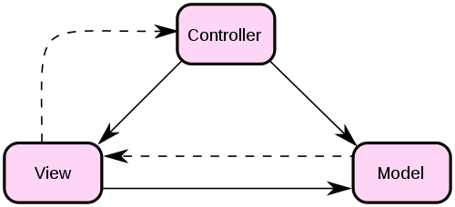
Original MVC (hello, 1970s)
Manage user requests
Initiates model behavior
Select view response
User events
View selection
State Change
Change notification
State query
Receives model data
Requests model data
Presents view
Encapsulates application
functions and data
Invocations
Events

Slide 21
Class Activity
Each team will prepare a short ~five minute presentation of an architectural pattern
  Context, problem, solution, constraints/weaknesses
  Example view (not from the text)
Team 1 – Broker
Team 2 – Event Driven
Team 3 – Publish-Subscribe
Team 4 – Pipe-and-Filter
Team 5 – Map-Reduce
Team 6 – Microservices

Slide 22
Client-Server Pattern
Context
  Large number of clients want access to resources / services
    Emails, data, banking accounts
  We want
    Control access & quality
    Modify & reuse resources & services
    Scalability control center (client performance is limited)
  Primary QA: Scalability
Problem
  Duplication (every client has logic & copied resources)
  Need to control & modify each client individually
    e.g. cannot force mobile app update

Slide 23
Client-Server Pattern
Solution
  Clients request services / data from servers
    Responsible for presenting data
  Some components may act as both clients and servers (e.g., microservices)
  There may be one central server or multiple distributed ones
Benefits
Modifiability – in one place
Reusability – for many clients
Scalability – distributed workload for many server instances (impossible for clients)
Availability – centralized failover / replication management
Security – policies enforced in one place
Weaknesses
Scalability limits – server resources are not infinite
Single point of failure – if a server is down, everything stops
  Or a bottleneck if slow
Difficult client/server split sometimes
    e.g. physics calculations in an online game

Slide 24
Client-Server – Specification
Elements
  Client – a component that invokes services of a server component
    Clients have ports that describe the services they require
  Server – a component that provides services to clients
    Servers have ports that describe the services they provide
Relations
  Uses — Client invokes Server through a request/reply connector (synchronous; local or remote; optionally encrypted)
Constraints
  Clients are connected to servers through request/reply connectors.
  Server components can be clients to other servers.

Slide 25
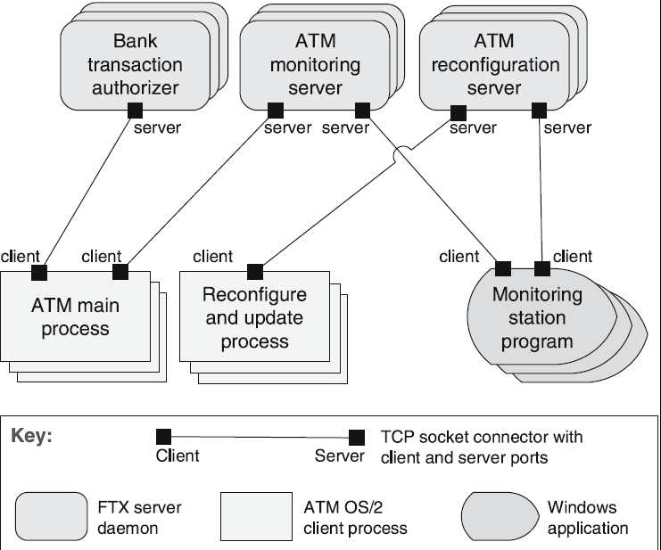
Client-Server Example
ATM Banking System

Slide 26
Peer-to-Peer Pattern
Context
  All entities are logically equal in design, but not necessarily equal in practice
    E.g. super-nodes, bootstrap nodes
  Each entity provides its own resources
  Have to cooperate to produce value
  Primary QAs: Scalability, Availability
Problem
  How to coordinate entities without a central coordinator?
  How to provide high availability & scalability without a coordinator?

Slide 27
Peer-to-Peer Pattern
Solution
  Entities interact directly as peers
  No entity is more important than another
  Algorithmic / architecture mediation / decision making
    e.g. BitTorrent, partially pre-MS Skype, partially blockchains
Benefits
  Scalability – adding more peers is easy
  High availability – no single point of failure
  Resource sharing – data & computations are distributed
Weaknesses
  Coordination complexity – need specialized algorithms
  Security risks – no central point of enforcement
  Performance variability – peers are not equal (& topology can change)
  Trust problem – can one peer trust another
    e.g. copyright owner within BitTorrent piracy network

Slide 28
Peer-to-Peer – Specification
Elements
  Peer – an independent component running on a network node
    Special peer components can provide routing, indexing, and peer search capability
Relations
Uses — Peers invoke each other through a request/reply connector (synchronous request or fire-and-forget); attachments may change at runtime
Constraints
  Restrictions may be placed on the following
    The number of allowable attachments to any given peer
    The number of hops used for searching for a peer
    Which peers know about which other peers
    Some P2P networks use star topologies where peers only connect to supernodes

Slide 29
Peer-to-Peer Governance
  Peers are logically equal
    Some can have different roles or more authority
  Rule-based interactions
    e.g. in BitTorrent you drop slow nodes & connect to fast ones
  Sometimes system-wide restrictions, e.g.
    Connection limits – how many connections per node
    Hop limits – how far a request can go
    Knowledge distribution – which peers know about each other
    etc
  Issues
    More complex structure – decentralization is weaker / harder
      Need more rules for more complex networks

Slide 30

Peer-to-Peer Pattern (Skype)
Skype is dead, baby, Skype's dead
MS
  Centralized
    Government requirements, Azure integration, monetization, reliability, …
Pre-MS
  Auth server
  Messages / calls - Peer-to-peer
  IP-address disclosure
  Both must be online
  Skype infrastructure is cheap

Slide 31
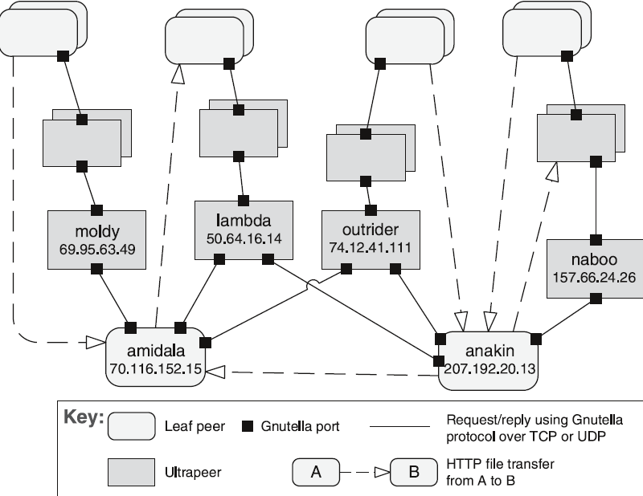
Peer-to-Peer Example
Gnutella Network

Slide 32
Service Oriented Architecture Pattern
Context
  Services are offered (& described) by providers and consumed by consumers
  Primary QA: Interoperability
Problem
  Different organizations, different platforms, different languages, different locations
  How to support interoperability?
Solution
  Each service is self-contained & exposes an interface
  Loose coupling - don’t care about implementation
  Benefits
  The same as for Client-Server
    Modifiability, Reusability, Scalability, Availability, Security
Weaknesses
  Complexity
    Network latency, interface versioning, service governance
What’s the difference between SOA & Client-Server?
Notes:
Difference:
CS – small scale (these 2 entities)
SOA – whole enterprise system is designed this way
Fundamentally - about the same story

Slide 33
Service Oriented Architecture – Specification
Elements
  Components
    Service providers - provide one or more services through declared interfaces.
    Service consumers - invoke services directly or through an intermediary
    Service providers - may also be service consumers.
  Enterprise Service Bus (ESB) - route and transform messages between providers and consumers
    Necessary when external partners have heterogeneous formats
    5 providers with different formats X 5 consumers = 25 parsing implementations
    Cannot mandate external partners standardize their interfaces
  Registry of services - used by providers to register their services and by consumers to discover services at runtime.
  Orchestration server – set of workflows
    Chains of interactions to fulfill a business process

Slide 34
Service Oriented Architecture – Specification
  Connectors
    SOAP connector
      Uses the SOAP protocol for
        Synchronous communication between web services, typically over HTTP
        Strongly typed
        XML-based
    REST connector
      Relies on the basic request/reply operations of the HTTP protocol
    Asynchronous messaging connector
      Uses an asynchronous messaging system - point-to-point or publish-subscribe

Slide 35
Service Oriented Architecture – Specification
Relations
Attachment of the different kinds of components available to the respective connectors
  e.g. providers attach to SOAP or REST connectors; consumers attach to whichever the provider exposes
Constraints
  Consumers are connected to service providers
  Intermediary components (e.g. ESB, registry, orchestration server) may be used
  Cannot bypass interfaces

Slide 36
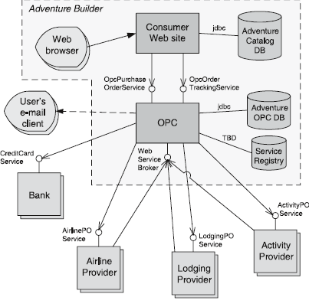
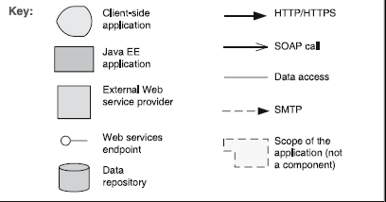
Service Oriented Architecture Example
“Adventure Builder”
OPC – Order Processing Center

Slide 37
Shared-Data Pattern
Context
  Various computational components share and manipulate large amounts of data
  Data doesn’t belong to any component fully
  Primary QA: Availability
Problem
  Store reliably
  Consistency
  Avoid duplications
  Parallel access by independent actors (components & people & 3rd-party systems)

Slide 38
Shared-Data Pattern
Solution
  Shared data storage
  Accessed by different components (accessors)
  Reading & writing
  Not everyone needs the same permissions
Benefits
  Consistency – single source of truth
  Reusability – all accessors use the same dataset
  Scalability – data store scales independently of its consumers
  Decoupling – no direct data requesting
    Avoid sync requests and affecting IOPS
  Security - not all accessors have equal permissions
Weaknesses
  Performance bottleneck – avoid having all components write synchronously to a single store
    e.g. everybody writes into one DB
  Concurrent writes – have to be designed around
    e.g. no data is updated, only new is written
  Single point of failure – unavoidable
    Centralization benefits consistency but concentrates availability risk

Slide 39
Shared Data – Specification
Elements
  Shared-data store. Concerns include
    Types of data & structure
    Access performance (read/write latency, throughput)
    Data distribution (centralized vs replicated vs distributed)
    Number of accessors (parallel access)
  Data accessor component
    e.g. reporting service can read OR data pipeline can write
Relations
Accessors – attach to the data store through read/write connectors (SQL queries, file system I/O, API calls)
Data Store – may also initiate control through events or triggers
Constraints
  Data accessors interact only with the data store(s)

Slide 40
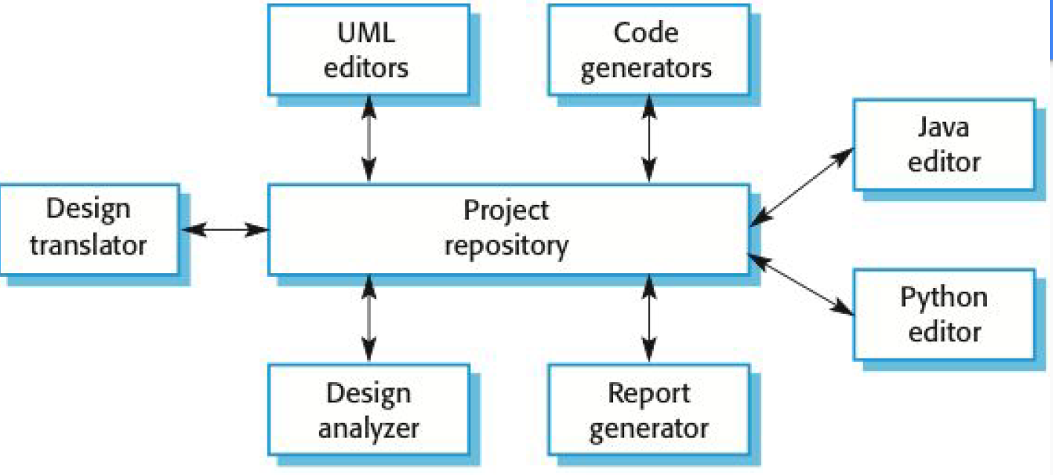
Shared Data Example
Project repository = the single source of truth
Components interact with the store, not with each other — decoupling

Slide 41
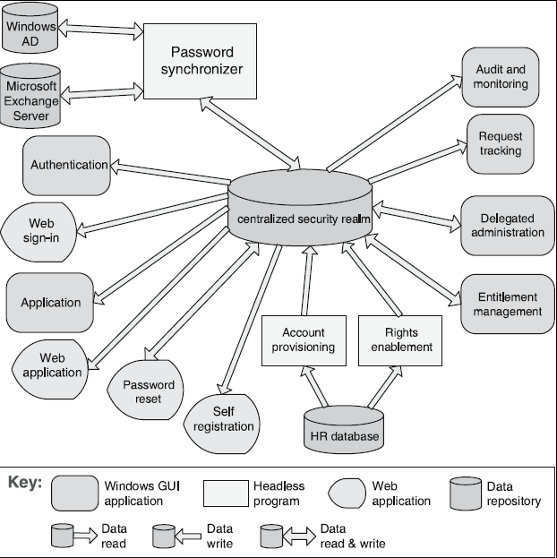
Shared Data Example
Enterprise Access Management System

Slide 42
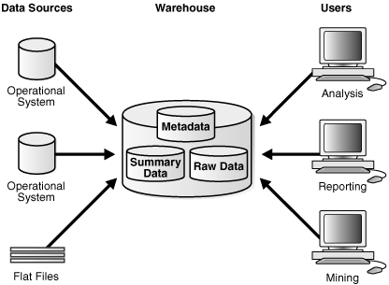
Data Warehouse Example
ETL pipeline: source data is extracted, transformed, and loaded into the warehouse on a scheduled basis
Consumers query (read) from the warehouse — arrows show the access relationship, not data flow direction
Oracle – Introduction to Data Warehousing Concepts

Slide 43
Blackboard Pattern
Context
  Problem domain is immature / poorly specified
  No optimal / deterministic solution is known
  Need complex / non-deterministic strategies to solve a problem
  e.g. robotic lawn mower: LIDAR, camera, GPS, and odometry modules each write to a shared world model — no single module has the full picture
  Primary QA: Modifiability
Problem
  Often requires several fields of expertise
  Set of intermediate solutions & representations from each
    e.g. voice phonemes words meaning (original motivation — HEARSAY II, 1970s)

Slide 44
Blackboard Pattern
Solution
  Collection of independent specialized programs work cooperatively
  Utilizing a common data structure (blackboard) as the only communication channel
  Central controller coordinates the efforts
    Based on the current state
Benefits
  Flexibility – can swap modules / agents / programs
  Expertise collaboration
  Exploratory power – can find non-deterministic solutions
  Complexity scalability – can plugin new experts if needed
Weaknesses
  Complexity – hard to design & make it produce good results
    Orchestration rules specifically
  Hard to guarantee quality
  Debug difficulty – different agents, non-deterministic behavior
  Low support for parallelism
    Concurrent writes require coordination

Slide 45
Blackboard Pattern – Specification
Elements
  Knowledge source – independent subsystems that solve specific aspects of the problem
  Blackboard – central data store for solution space, provides an interface to knowledge sources
  Control – coordinates knowledge source activation based on current blackboard state
Relations
  Knowledge sources interact exclusively through the blackboard — no direct peer-to-peer communication
  Activates – Controller selects and invokes knowledge sources; knowledge sources do not activate each other
Constraints
  There must be exactly one blackboard, shared by all knowledge sources and the controller
  Knowledge sources are activated opportunistically — only when their expertise applies to the current blackboard state
  Control strategy may be heuristic — the controller itself need not be deterministic

Slide 46
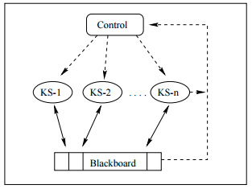
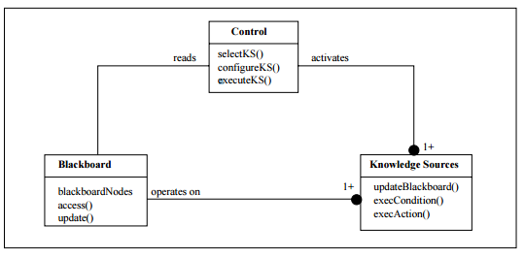
Blackboard Example
e.g. robotic mower:
KS-1 = LIDAR, KS-2 = camera, KS-n = GPS
Blackboard = shared world model
Control = navigation planner
Conceptual view — control loop between components
UML Class Diagram — component interfaces & control loop methods

Slide 47
Allocation Patterns
decomposition of the system

Slide 48
Multi-Tier Pattern
Context
  Distributed deployment
    → need to distribute a system’s infrastructure into distinct subsets
  Layers = logical separation of responsibility (always)
  Tiers = physical deployment boundary (independent machines/processes)
  Primary QA: Scalability
Problem
  How can we split the system into computationally independent execution structures—groups of software and hardware—connected by some communications?

Slide 49
Multi-Tier Pattern
Solution
  Execution structures are organized as a set of components by logical groupings
  Each grouping is termed a tier
Benefits
  Independent horizontal scaling per tier
  Security zone isolation (firewall between tiers)
  Independent failover
Weaknesses
  Network latency between tiers
  Distributed consistency
    Data replicated across tiers may fall out of sync
  Deployment complexity

Slide 50
Multi-Tier – Specification
Elements
  Tier – a physical grouping of software components deployed together on shared infrastructure
Relations
  Tight connections within tiers (e.g. in-process method calls)
  Interactions between tiers cross a network or process boundary
  Allocation mapping: each tier is deployed to specific hardware or infrastructure
Constraints
  A software component belongs to exactly one tier
  Tiers interact only through defined interfaces – no layer bypassing

Slide 51
Multi-Tier Example
Consumer Web Site Java EE
Notes
OPC and Adventure Catalog DB appeared in the SOA example — the same system exhibits both SOA and Multi-Tier patterns
Within the Web tier: layered structure
  SignOnFilter → Servlets → JSPs
Between tiers: physical boundaries

Slide 52
Broker Pattern
Context
  Services are distributed across multiple servers
    Each server provides independent, reusable services
    Systems must interoperate — connect and exchange information
    Availability of component services must be ensured
  Primary QAs: Modifiability, Interoperability
Problem
  How do we structure distributed software so that service users do not need to know the nature and location of service providers, making it easy to dynamically change the bindings (runtime connections) between users and providers?
  Services should be replaceable or relocatable without requiring client changes

Slide 53
Broker Pattern
Solution
  Separates service users (clients) from service providers (servers) via an intermediary broker
  Client queries broker via service interface; broker forwards to a server
  Clients and servers remain location-independent of each other
Benefits
  Location transparency – clients don’t need to know server locations
  Modifiability – providers swap or relocate without touching clients
  Interoperability – clients and servers independent of each other’s implementation
  Scalability – broker routes to multiple server instances
Weaknesses
  Latency – broker adds indirection; may become a bottleneck
  Single point of failure – broker down = everything stops
  Up-front complexity – non-trivial infrastructure
  Security target – high-value attack surface
  Difficult to test – hard to simulate distributed interactions

Slide 54
Broker Pattern – Specification
Elements
  Client – a requester of services
  Server – a provider of services
  Broker – an intermediary that locates an appropriate server to fulfill a client’s request, forwards the request to the server, and returns the results to the client
  Client-side proxy – an intermediary that manages the actual communication with the broker, including marshaling, sending, and unmarshaling of messages
  Server-side proxy – an intermediary that manages the actual communication with the broker, including marshaling, sending, and unmarshaling of messages
Relations
The attachment relation associates clients (and, optionally, client-side proxies) and servers (and, optionally, server-side proxies) with brokers
Constraints
The client can only attach to a broker (potentially via a client-side proxy). The server can only attach to a broker (potentially via a server-side proxy)

Slide 55
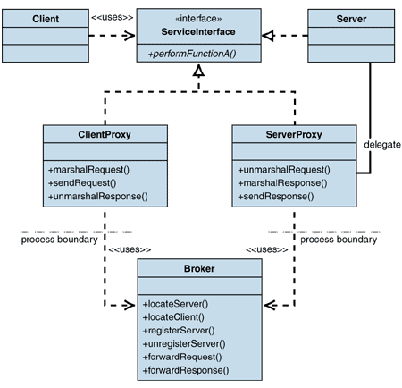
Broker Example

Slide 56
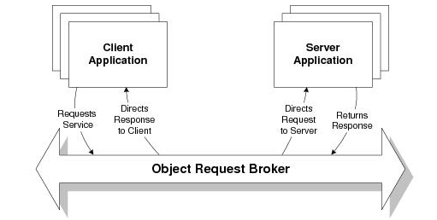
Broker Patterns in the Wild
CORBA: Common Object Request Broker Architecture
  Actively developed from 1991 – 2002
Enterprise Java Beans
Microsoft .NET Platform (DCOM / WCF)
Service Oriented Architectures depend on the Broker Pattern
CORBA Programming Model

Slide 57
Pipe and Filter Pattern
Context
  Many systems must transform streams of discrete data items from input to output
    Many transformations repeat across different systems
    Desirable to build them as independent, reusable parts
  Primary QAs: Performance, Modifiability
Problem:
  How can data streams be processed by reusable, loosely coupled components with simple, generic interaction mechanisms?
    Tightly coupled implementations cannot be flexibly recombined or reused across systems
    Single-component pipelines resist modification and cannot exploit parallel hardware

Slide 58
Pipe and Filter Pattern
Solution
  Data flows through a pipeline of filters connected by pipes
    Filter — transforms data at its input port(s) and writes results to its output port(s)
    Pipe — conveys data from a filter's output to another filter's input; preserves order, does not alter data
Benefits
  Reusability – filters can be recomposed into new pipelines
  Modifiability – filters can be added, removed, or replaced independently
  Concurrent execution – independent filters can run in parallel
  Testability – each filter can be tested in isolation
Weaknesses
  Not suitable for interactive systems – sequential processing adds latency
  State sharing is difficult – filters cannot easily share global state
  Overhead – data must be parsed at each pipe boundary

Slide 59
Pipe and Filter – Specification
Elements
  Filter — a component that transforms data read on its input port(s) to data written on its output port(s)
  Pipe — a connector that conveys data from a filter's output port to another filter's input port; preserves order, does not alter data
Relations
  Attachment — associates the output of filters with the input of pipes and vice versa
Constraints
  Filters must be self-contained — they neither share state with other filters nor know the identity of upstream or downstream filters
  Pipes connect filter output ports to filter input ports
  Connected filters must agree on the type of data passed along the connecting pipe

Slide 60
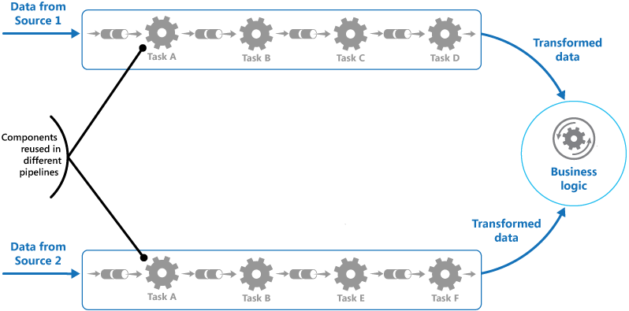
Pipe and Filter Example
Component & Connector View

Slide 61
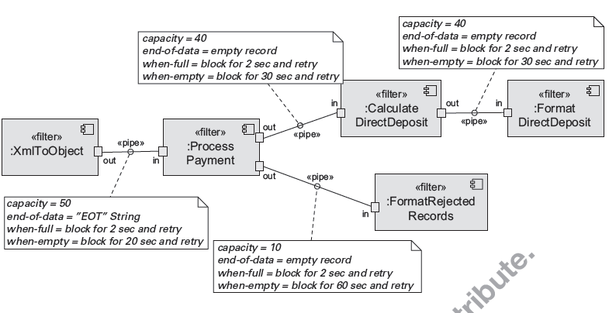
Pipe and Filter Example
C & C View – UML Component Diagram

Slide 62
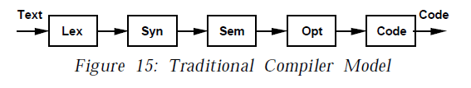
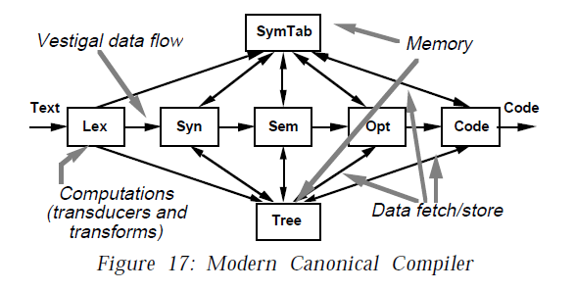
Pipeline Architecture Examples
Garlan, David, and Mary Shaw. “AN INTRODUCTION TO SOFTWARE ARCHITECTURE.”

Slide 63
Microservices Architecture Pattern
Context
  Deploy server-based enterprise applications supporting browser and native mobile clients
  Application handles client requests by executing business logic, database access, messaging with other systems, and third-party API calls
  Primary QAs: Modifiability, Deployability
Problem
  Monolithic applications become too large and complex for efficient support and deployment
  Cloud and distributed environments require optimal resource utilization that monoliths cannot easily provide
http://martinfowler.com/articles/microservices.html

Slide 64
Microservices Architecture Pattern
Solution
  Build applications as suites of independently deployable and scalable services, each with its own API boundary
  Services can use different languages, manage their own databases, and be developed by different teams
Benefits
  Independent scalability — each service scales on its own based on demand
  Technology diversity — teams choose the best language and database per service
  Fault isolation — a failed service does not bring down the entire application
  Team autonomy — independent deployment enables faster delivery cycles
Weaknesses
  Systems must be designed to tolerate service failures; requires more system monitoring
  Service choreography and event collaboration overhead
  Decentralized data management — cross-service transactions are harder to manage
  Requires more memory — each service runs its own independent process

Slide 65
Microservices Architecture – Specification
Elements
  Service — an independently deployable component with its own API boundary; may be implemented in any language and manage its own database
  Client — web browser or native mobile application that invokes services via APIs
Relations
  Clients invoke services via HTTP RESTful interfaces or a lightweight message bus
  Each service exposes a well-defined API contract as its service boundary
Constraints
  Services must be independently deployable and isolate their own data (no shared databases across service boundaries)
  Services must tolerate failures of other services (e.g., circuit-breaker pattern)
  Teams must have the expertise to make good service decomposition decisions

Slide 66
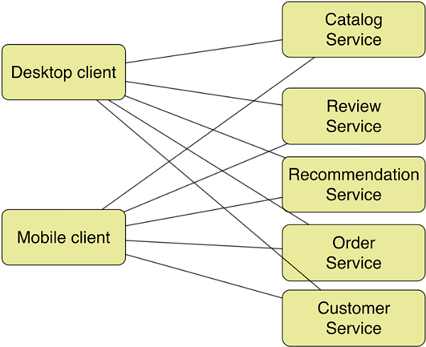
Microservices Architecture Pattern Example
Architecture style used by Amazon and Netflix

Slide 67
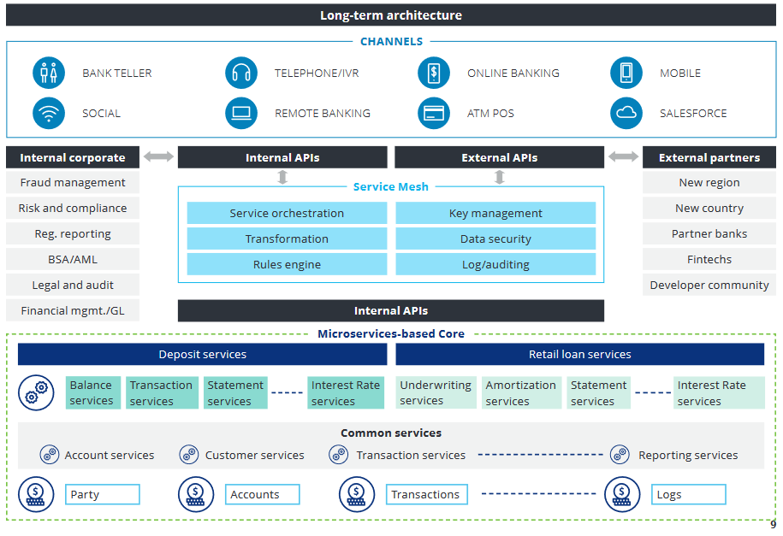
Microservices in the Wild
Deloitte Banking Platform
https://www2.deloitte.com/content/dam/Deloitte/us/Documents/financial-services/us-enabling-platform-banking-pov.pdf

Slide 68
Event Driven Architecture
Context
  Computational and information resources must handle incoming independent asynchronous application-generated events
  System must be able to scale up as demand increases
  Primary QAs: Scalability, Availability, Performance
Problem
  How do we construct distributed systems that can service asynchronously arriving messages associated with an event?
  System must scale from small and simple to large and complex
Software Architecture Patterns, Mark Richards

Slide 69
Event Driven Architecture
Solution
  Deploy independent event processors for event handling
  Arriving events are queued; a scheduler distributes them to the appropriate handler based on scheduling policy
Benefits
  Scalability — event handlers scale independently based on queue depth
  Loose coupling — producers and handlers have no knowledge of each other
  High availability — asynchronous processing absorbs load spikes without blocking
Weaknesses
  No built-in transactional support — applications must manage consistency explicitly
  Inherent complexity of deploying and coordinating distributed systems
  Performance and error recovery may be difficult to manage

Slide 70
Event Driven Architecture – Specification
Elements
  Event queue — holds incoming events awaiting processing
  Scheduler — dispatches events from the queue to the appropriate handler based on scheduling policy
  Event handlers — process specific event types; may be deployed as independent processes and/or processors
Relations
  Clients and event handlers are typically distributed on a network but need not be
  Message communication protocols and formats should be consistent and standards-based
Constraints
  No built-in transactional support — scheduling policy must direct each event to the correct handler type
  Handlers must not share state; each processes events independently
Software Architecture Patterns, Mark Richards

Slide 71
Event Driven Architecture Example
Mediator topology – orchestrate multiple steps to handle an event according to some application policy
Broker topology – distribute messages in a simple chained message flow
Software Architecture Patterns, Mark Richards

Slide 72
Publish-Subscribe Pattern
Context
  There are a number of independent producers and consumers of data that must interact
  The precise number and nature of producers and consumers are not predetermined or fixed, nor is the data they share
  Primary QAs: Modifiability, Interoperability
Problem
  How can we create integration mechanisms that transmit messages among producers and consumers so they are unaware of each other's identity, or even existence?

Slide 73
Publish-Subscribe Pattern
Solution
  Components interact by announcing events; publishers publish one or more events to which other components may subscribe
  The event manager invokes all registered subscribers when the event occurs; the connector delivers events to subscribing components
Benefits
  Loose coupling — publishers and subscribers have no knowledge of each other’s identity
  Extensibility — new subscribers can be added without modifying publishers
  Broadcast — a single published event reaches all registered subscribers automatically
Weaknesses
  Typically increases latency; negative effect on scalability and predictability of message delivery time
  No guarantee on ordering of messages
  Delivery of messages is not guaranteed

Slide 74
Publish-Subscribe – Specification
Elements
  Any C&C component with at least one publish or subscribe port
  The publish-subscribe connector, with announce and listen roles for publishers and subscribers respectively
Relations
  Attachment — associates components with the publish-subscribe connector; prescribes which components announce events and which are registered to receive them
Constraints
  All components are connected to an event distributor (bus connector or component)
  Publish ports attach to announce roles; subscribe ports attach to listen roles

Slide 75
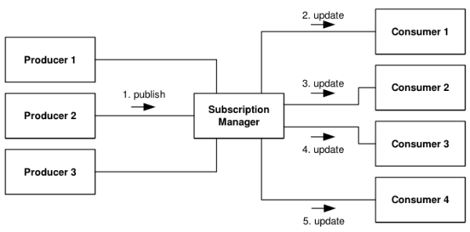
Publish-Subscribe Example

Slide 76
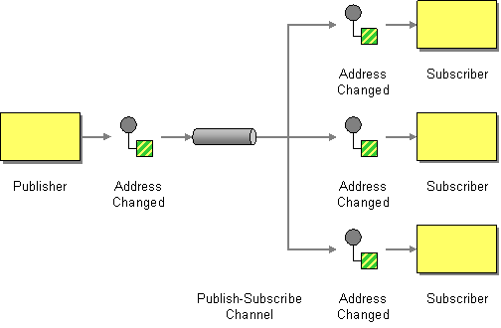
Publish-Subscribe Example
http://www.enterpriseintegrationpatterns.com/patterns/messaging/PublishSubscribeChannel.html

Slide 77
Map-Reduce Pattern
Context
  Businesses have a pressing need to quickly analyze enormous volumes of data they generate or access, at petabyte scale
  Primary QAs: Performance, Scalability
Problem
  How can we efficiently perform a distributed and parallel sort and analysis of an ultra-large data set, with a simple means for the programmer to specify the analysis?
    For many applications, sorting then analyzing grouped data is sufficient, but a single machine cannot scale to petabyte-scale sets

Slide 78
Map-Reduce Pattern
Solution
  Three parts: specialized infrastructure, a programmer-specified map function (filters/extracts data), and a programmer-specified reduce function (combines results)
  Infrastructure handles parallel deployment, data sorting, and failure recovery
Benefits
  Parallelism — map instances run concurrently across many processors
  Scalability — handles petabyte-scale data sets efficiently
  Fault tolerance — infrastructure automatically detects and recovers from node failures
  Programmer simplicity — developer specifies only map and reduce; infrastructure handles the rest
Weaknesses
  Not justified for small data sets — overhead exceeds benefit
  If data cannot be divided into similar-sized subsets, parallelism advantages are lost
  Operations requiring multiple reduces are complex to orchestrate

Slide 79
Map-Reduce – Specification
Elements
  Map — a function with multiple instances deployed across processors; performs the extract and transformation portions of the analysis
  Reduce — may be deployed as single or multiple instances; performs the load portion (ETL)
  Infrastructure — deploys map and reduce instances, shepherds data between them, and detects/recovers from failure
Relations
  Deploy-on — relation between a map or reduce instance and the processor it runs on
  Instantiate, monitor, and control — relation between the infrastructure and the map and reduce instances
Constraints
  The data to be analyzed must exist as a set of files
  Map functions are stateless and do not communicate with each other
  The only inter-instance communication is <key, value> pairs emitted from map instances to reduce instances

Slide 80
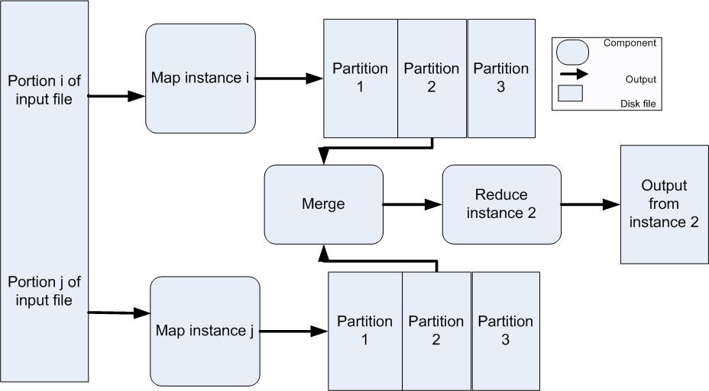
Map-Reduce Example

Slide 81
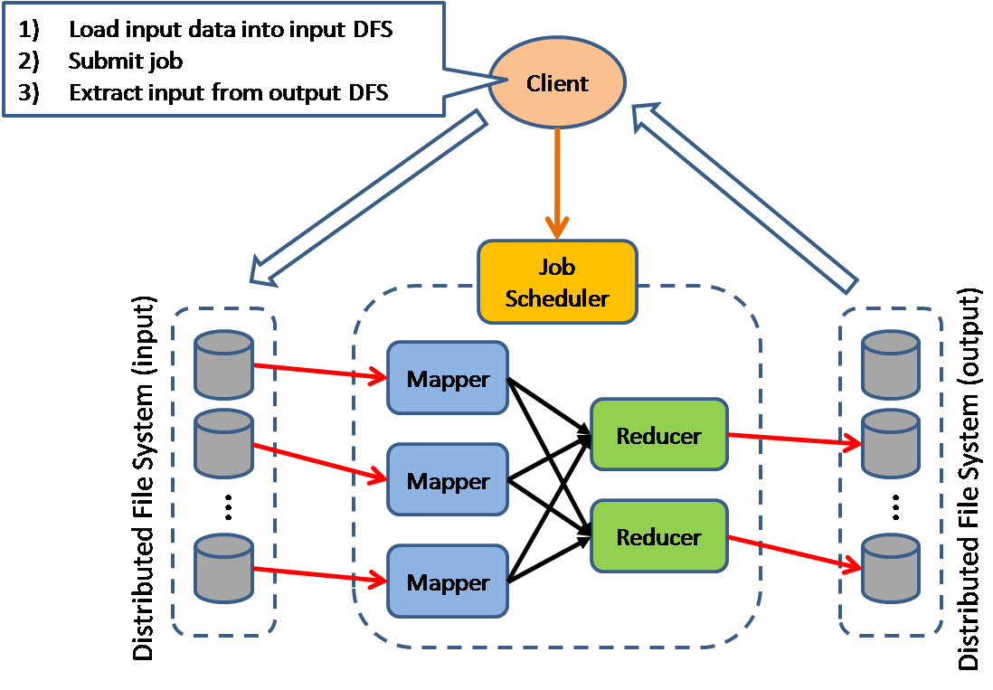
Another Map-Reduce View

